Slide 1


Intermediate Web Scraping in Python (Selenium)

Slide 2
Outline
Review: Web Scraping
Python Web Scraping Demo

Slide 3
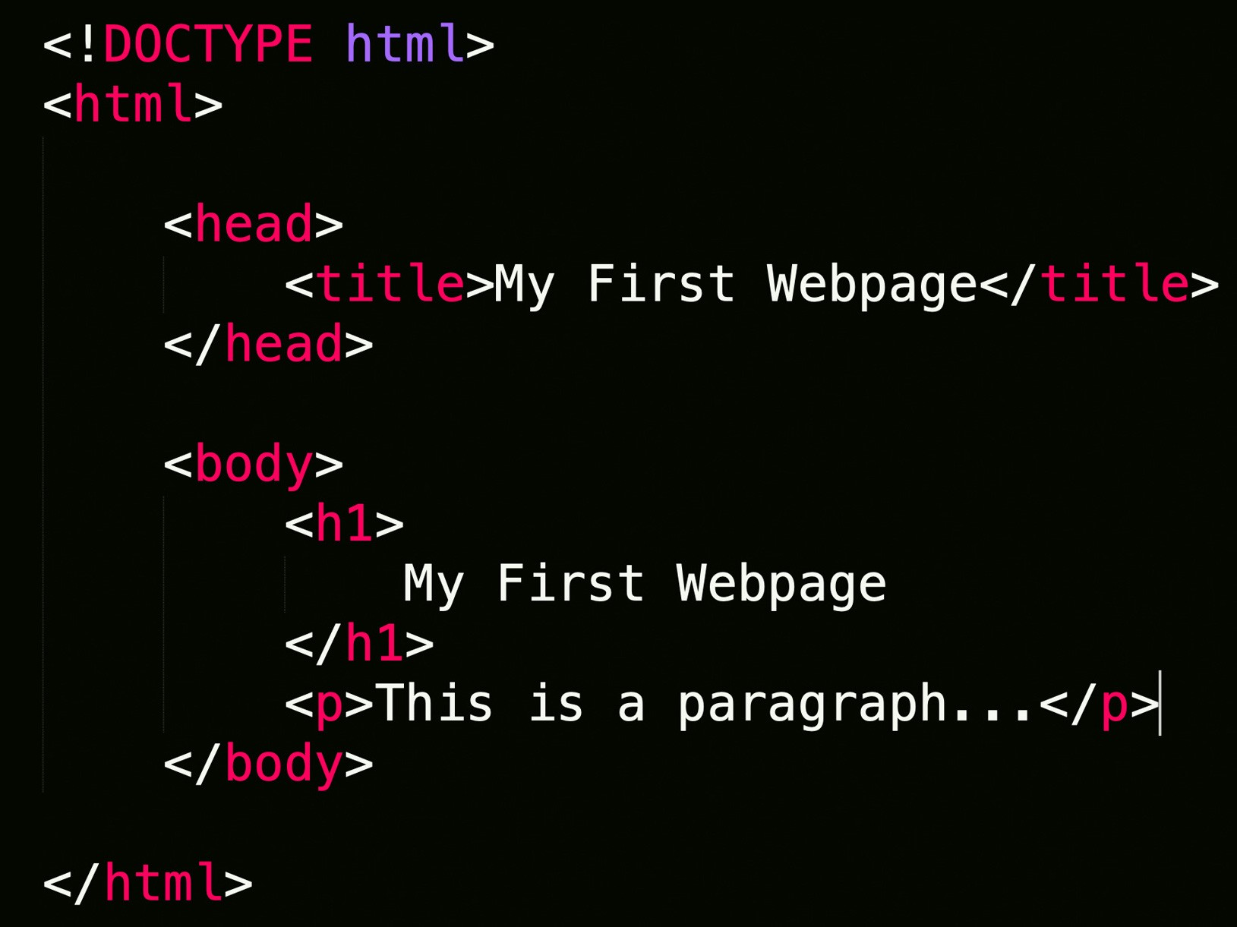
Web Scraping
Extraction of data from a website.
Loads HTML code from URL. User selects which content to keep

Slide 4







Slide 5
Selenium Example
Link below to Sample Code
https://colab.research.google.com/drive/1u46hzYInfiy9ZaT2NuJfdlnhDuGQaEBF?usp=sharing
Scraping principles for Selenium and BS4 are similar. Different Syntax
Goal: Traverse website link below. Extract price, title, description and reviews as before for all pages.
https://www.webscraper.io/test-sites/e-commerce/static/phones/touch

Slide 6
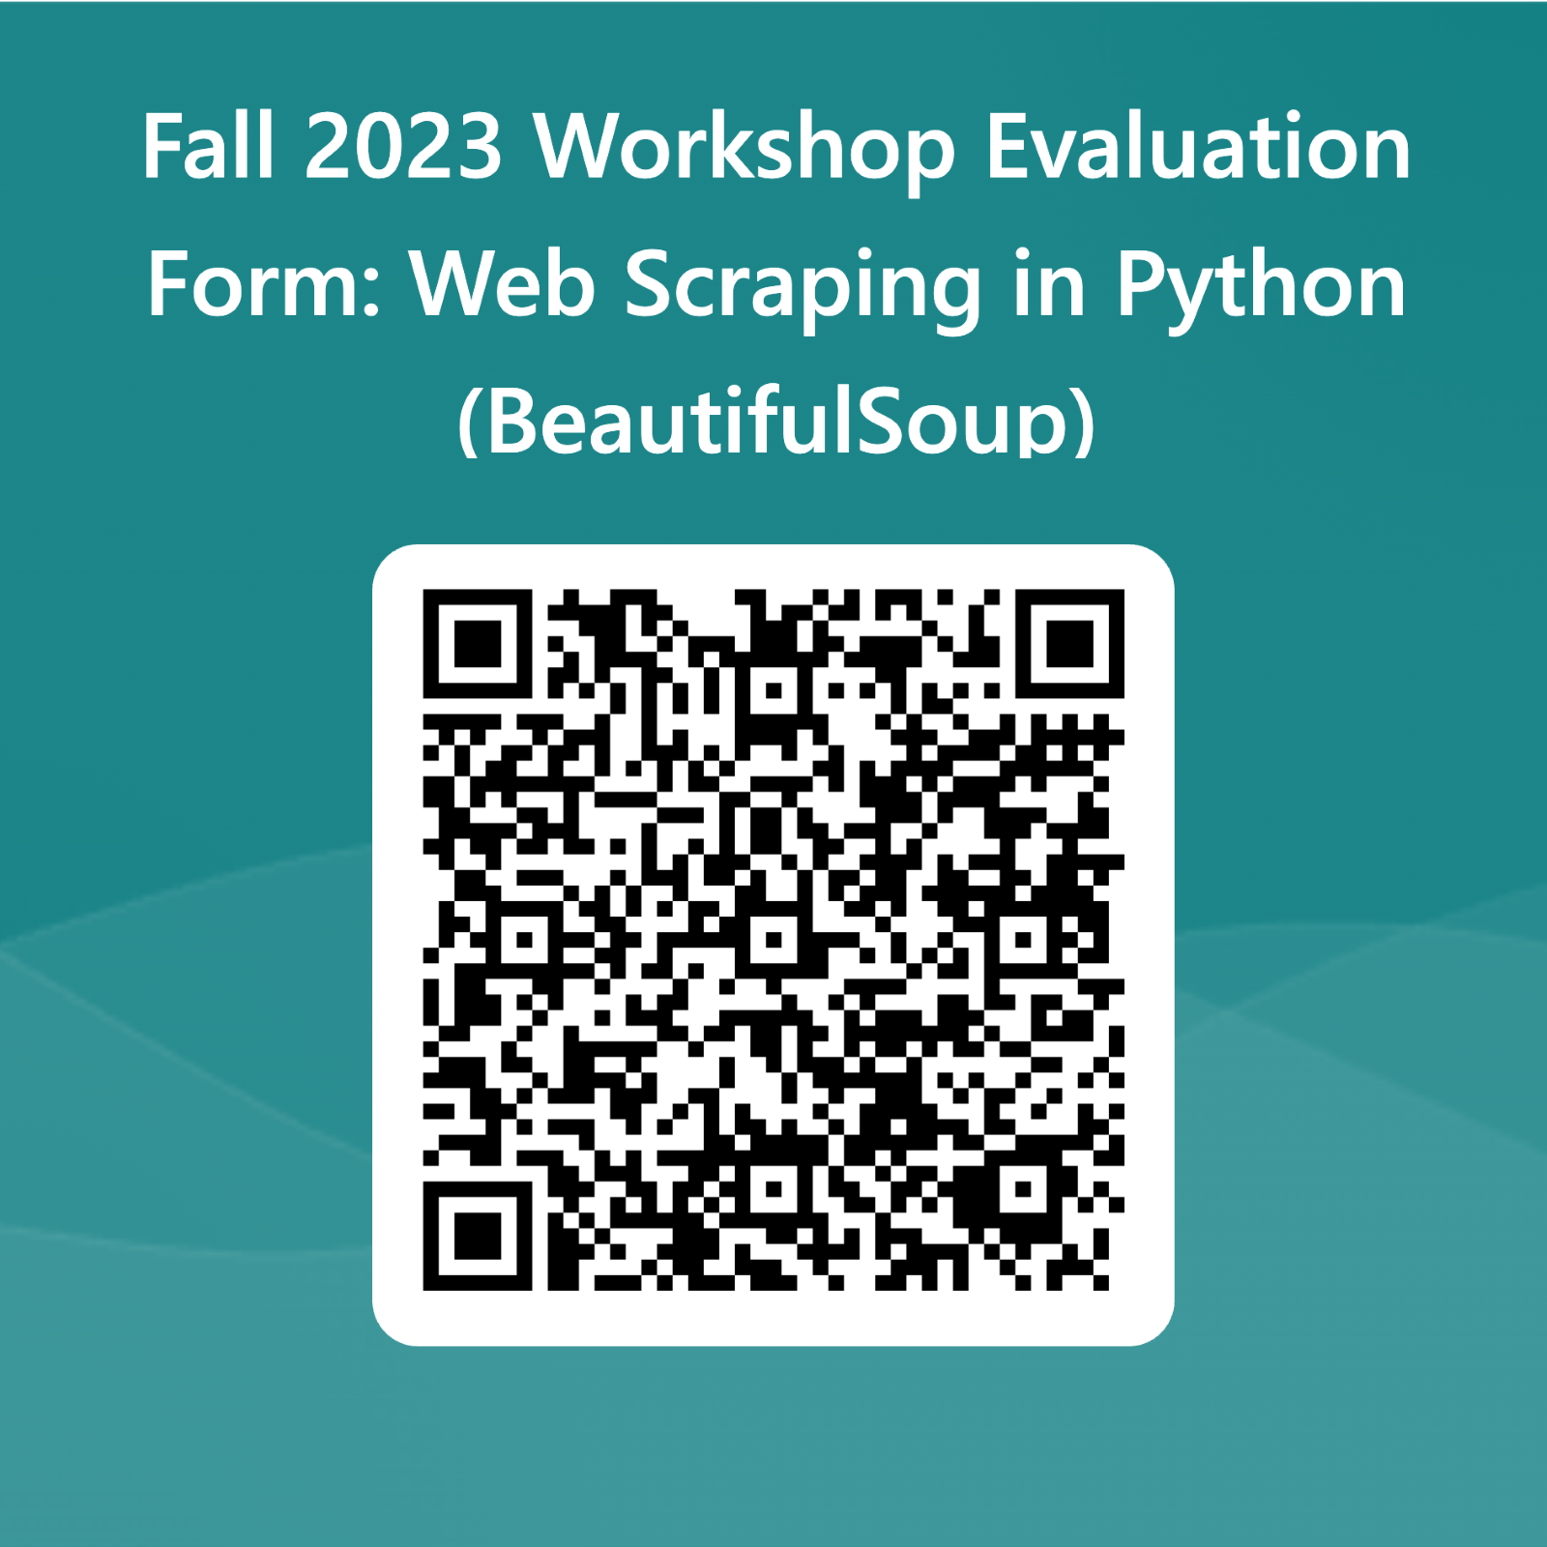
Evaluation

Slide 7
Thank you!
Contact us at CCSS-ResearchSupport@cornell.edu

